Slide 1

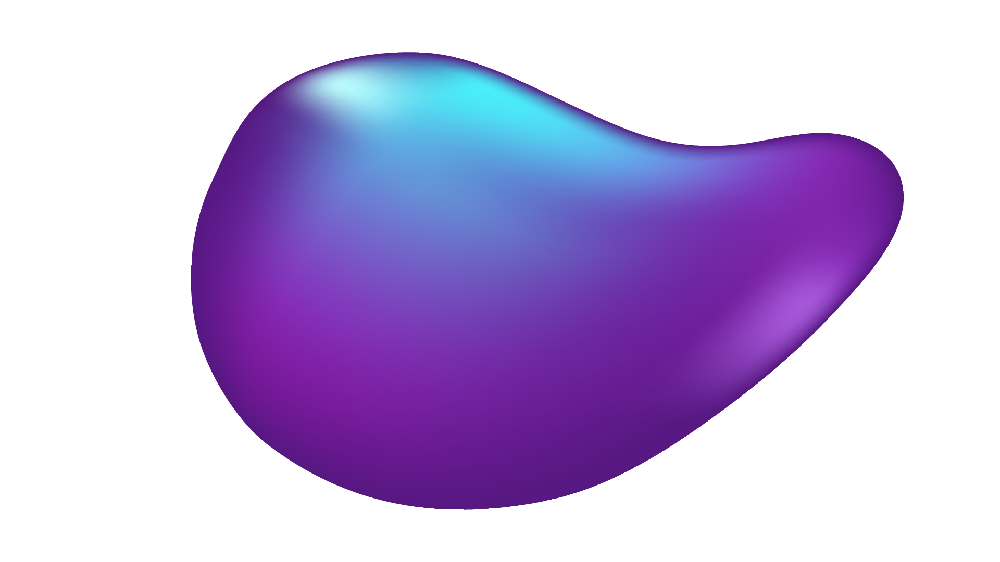



Din Kosberg - 315424671
Ryan (Ran) Wright - 305109613
Matan Oz - 318549607

Slide 2
RejectionGate Robust Rejection Mechanism for Reliable Histopathologic Cancer Classification

Slide 3
TABLE OF CONTENTS
01
02
03
04
What's the challenge?
Histopathologic Cancer Detection
Background & Motivation
Lack of Mechanism for Handling Uncertainty
Our Solution
RejectionGate Architecture
Project Milestones
Highlight significant key milestones

Slide 4
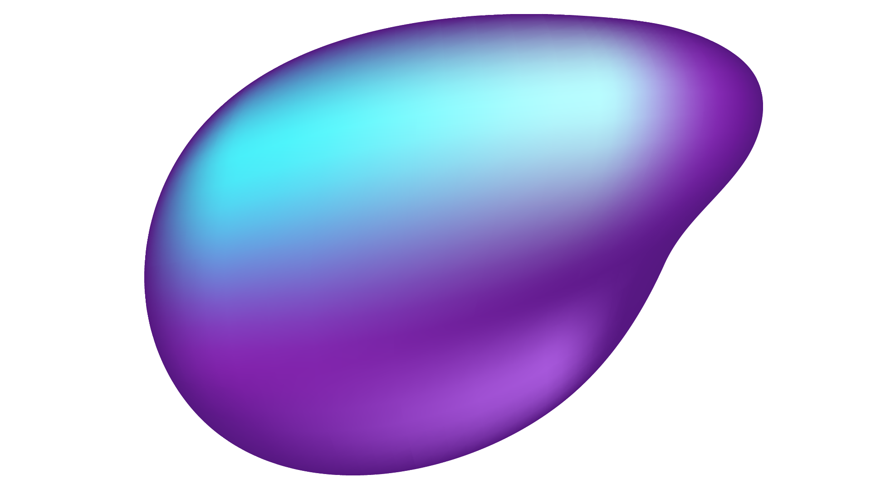
01
What's the challenge?
Histopathologic Cancer Detection

Slide 5
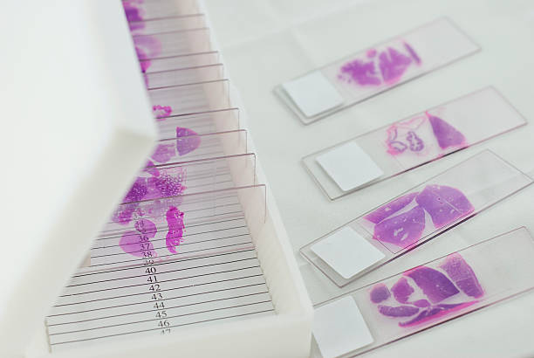
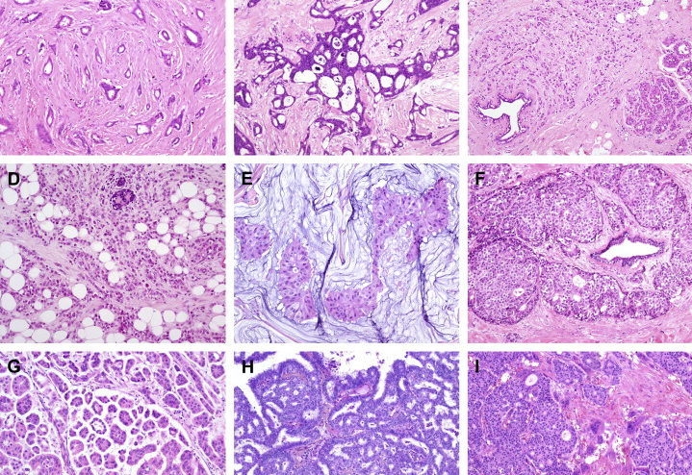
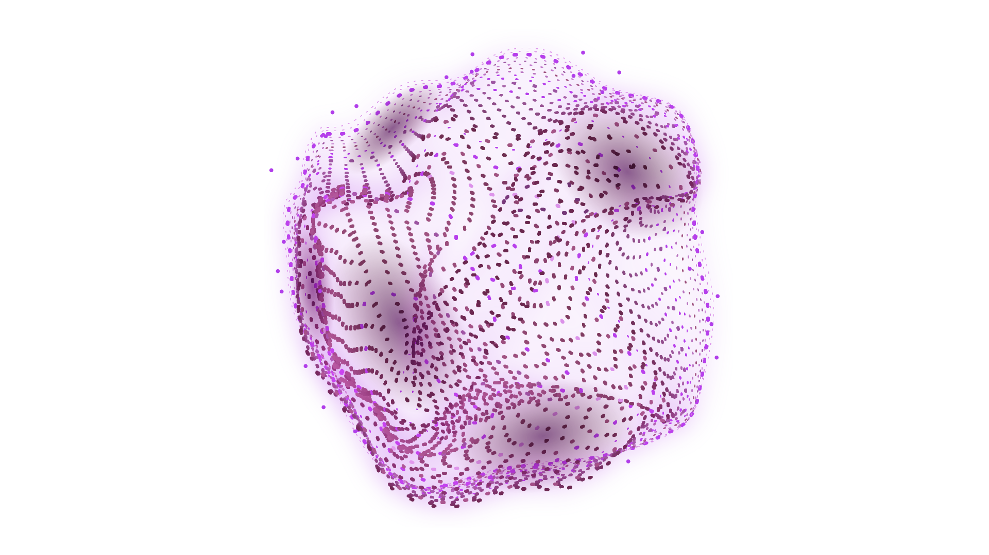
Histopathologic Cancer Detection
The process of diagnosing cancer by analyzing HE-stained histopathological images (tissue samples under a microscope).

Slide 6
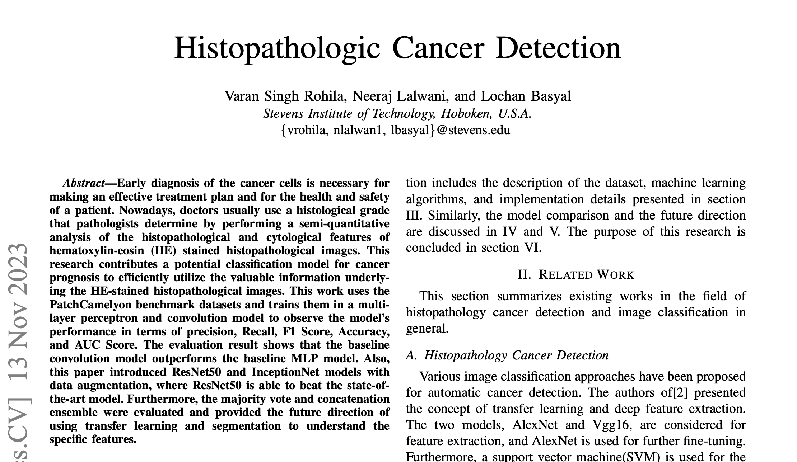
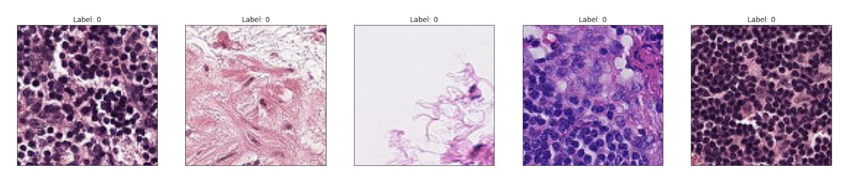
The Article
focuses on improving the accuracy and reliability of histopathologic cancer detection using deep learning techniques.

Slide 7
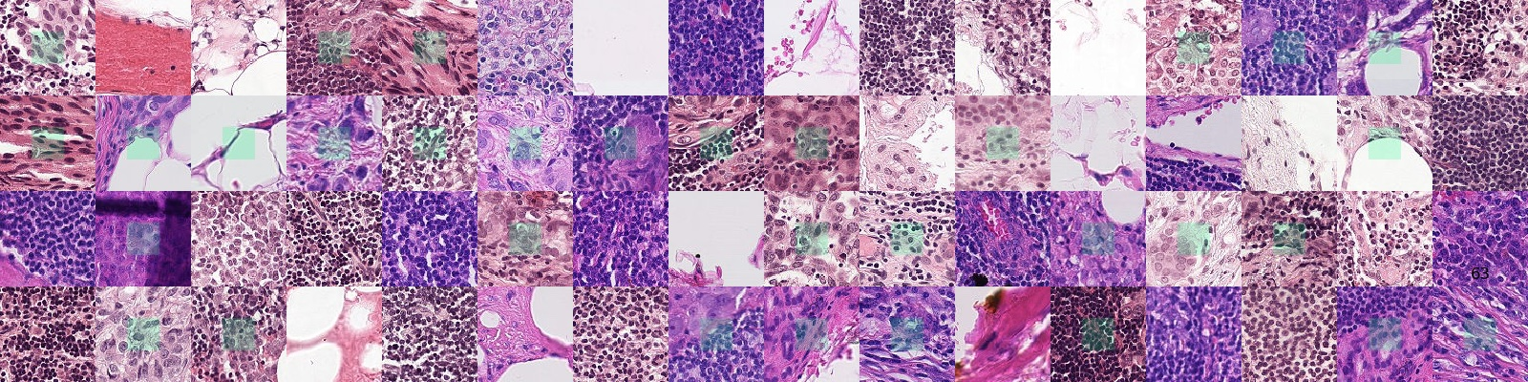
PatchCamelyon (PCam)
Dataset: PatchCamelyon (PCam) with 220,025 color images (96x96 pixels) of lymph node sections.
Labels: Binary labels (positive = metastatic tissue, negative = no metastatic tissue); focus on the central 32x32 pixel region.
Split: Train Set: 165,018 images; Test Set: 55,007 images.
Purpose: Benchmark dataset for training and evaluating deep learning models in histopathologic cancer detection.

Slide 8
02
Background & Motivation
THE NEED FOR REJECTION

Slide 9
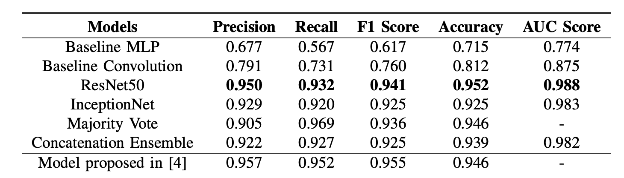
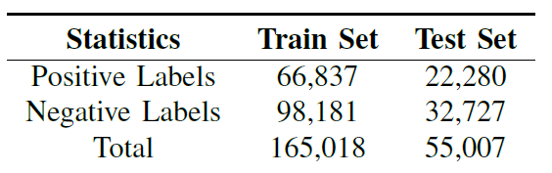
Histopathologic Cancer Detection
The article explores the use of deep learning for improving the accuracy of histopathologic cancer detection from HE-stained histopathological images.
It evaluates models such as Multi-Layer Perceptron (MLP), Convolutional Neural Networks (CNNs), and advanced architectures like ResNet50 and InceptionNet with data augmentation, showing that ResNet50 achieves state-of-the-art performance.

Slide 10
Histopathologic Cancer Detection
The article explores the use of deep learning for improving the accuracy of histopathologic cancer detection from HE-stained histopathological images.
It evaluates models such as Multi-Layer Perceptron (MLP), Convolutional Neural Networks (CNNs), and advanced architectures like ResNet50 and InceptionNet with data augmentation, showing that ResNet50 achieves state-of-the-art performance.
The study highlights the potential of ensemble methods, transfer learning, and segmentation techniques to enhance reliability and reduce uncertainty in cancer classification.

Slide 11
The Lack of Mechanism for Handling Uncertainty

Slide 12
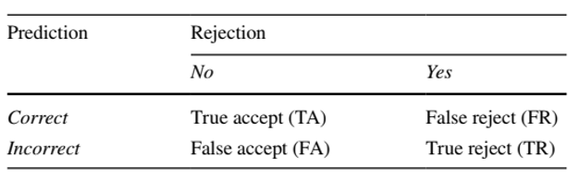
Motivation
Uncertainty: Advanced models (CNNs, ResNet50, InceptionNet) sometimes yield low-confidence predictions, risking misdiagnoses.
Clinical Risk: False positives lead to overtreatment; false negatives delay care, endangering patients.
Variability: Staining, tissue structure, and texture differences complicate classification, increasing uncertainty.
Reliability: A rejection mechanism improves precision by filtering low-confidence predictions, enhancing diagnostic safety.

Slide 13
03
Our Solution
RejectionGate Architecture

Slide 14
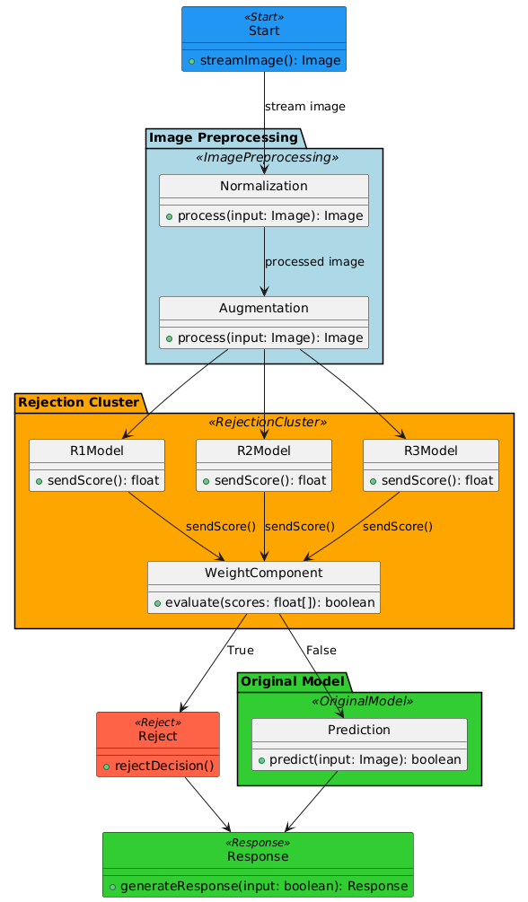
A SNEAK PEEK
RejectionGate Architecture

Slide 15
Image Preprocessing:
RejectionGate Architecture
Normalization: Standardizes input images.
Augmentation: Enhances training data with transformations like flips and rotations.

Slide 16
Rejection Cluster:
RejectionGate Architecture
Multiple models (R1Model, R2Model, R3Model) analyze the preprocessed image and generate confidence scores.
The WeightComponent aggregates these scores to evaluate overall confidence.

Slide 17
Decision Process:
RejectionGate Architecture
High Confidence: The prediction is passed to the Original Model for final classification
Low Confidence: The prediction is rejected to avoid potential misdiagnosis.
Only high-confidence predictions are accepted and returned as results, improving overall reliability.

Slide 18
Trade-off Between Rejection Rate vs Accuracy
RTA:
Rejection Rate% vs Accuracy% chart
Vary Thresholds: Test different confidence levels (e.g., 70%, 80%, 90%).
Evaluate Metrics: Measure accuracy, precision, recall, F1 score, and coverage for each threshold.
Line Plot:. Show how accuracy, precision, and recall change with increasing rejection rates.
Precision-Recall Curve: Visualize precision vs. recall at various thresholds.
Coverage vs. Performance: Use a scatter plot to display rejection rate vs. precision and recall.
Bar Chart: Compare the number of accepted and rejected predictions for each threshold.
ROC Curve: Plot the ROC curve to analyze performance and AUC across thresholds.

Slide 19
RejectionGate Architecture Flexibility

Slide 20
04
Project Milestones

Slide 21
Project Milestones
Model Architecture Implementation
Fine-Tuning & Prepare Presentation and Submission
WEEK 2
WEEK 5
WEEK 1
WEEKS 3-4
Project Setup and Data Preparation
Model Training and Validation

Slide 22
THANKS!
DO YOU HAVE ANY QUESTIONS?
Din Kosberg - 315424671
Ryan (Ran) Wright - 305109613
Matan Oz - 318549607

